Slide 1





Characterization of the Effects of Wing Sweep at Low Reynolds Number
Kylee Bennett, Davy Stanfield Brown, and Hunter Nudson
Mentor: Dr. Lance Traub
College of Engineering – Aerospace Engineering
Notes:
Don’t introduce if already said title
Say acknowledgements

Slide 2




Meet the Team
Kylee Bennett
Aerospace Engineering
Hunter Nudson
Aerospace Engineering
Davy Stanfield Brown
Aerospace Engineering
Mentor: Dr. Lance W. Traub
College of Engineering
Notes:
Davy

Slide 3
Research Purpose
UAVs and MAVs
Increase in use and application
Low Reynolds Number Research
Effects of sweep at low Reynolds number is not well characterized
The rise in use has caused a need for increased research on the performance of wings at low Reynolds numbers
Efficient design of UAVs and MAVs requires a better understanding of their associated aerodynamics
Notes:
Introduce what sweep, low Reynolds number, and what is desirable first before going into everything else

Slide 4
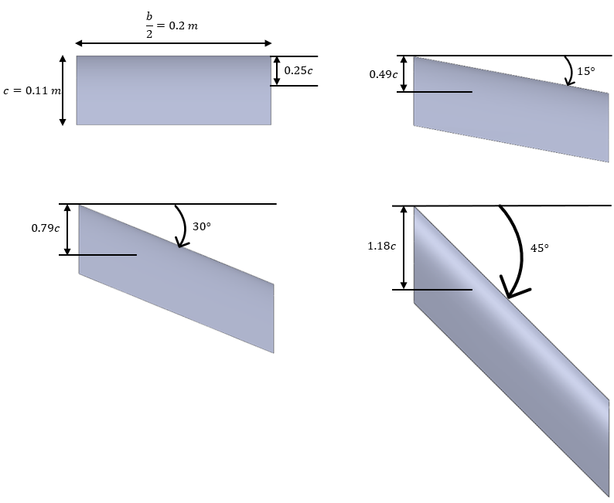
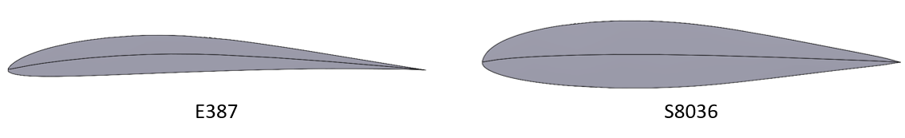
Research Introduction
Sweep Angle
0°
15°
Wing Profile
E387
S8036
30°
45°
Wing Dimensions
Wing profiles
Notes:
Why did we choose what airfoils we have
Explain what cord and wingspan is

Slide 5
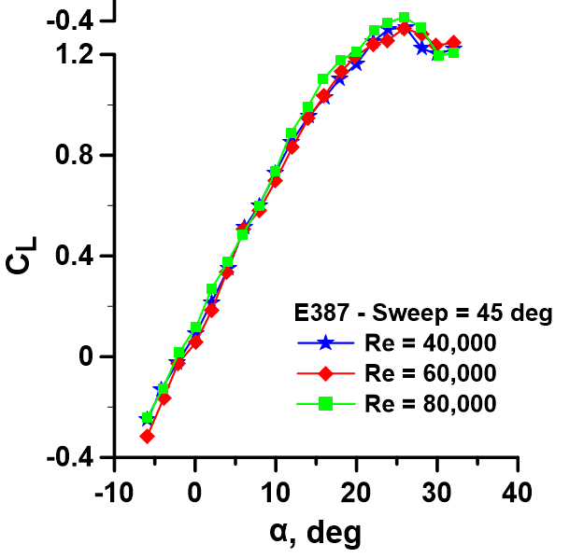
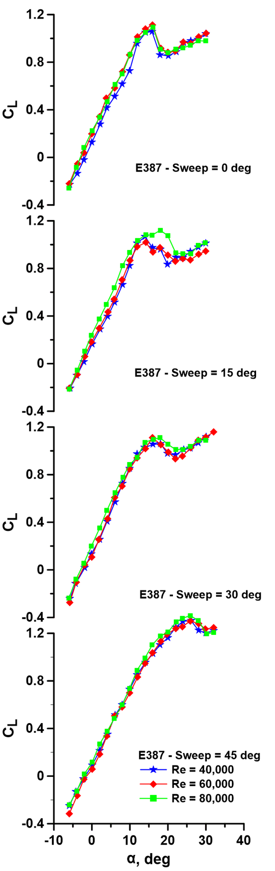
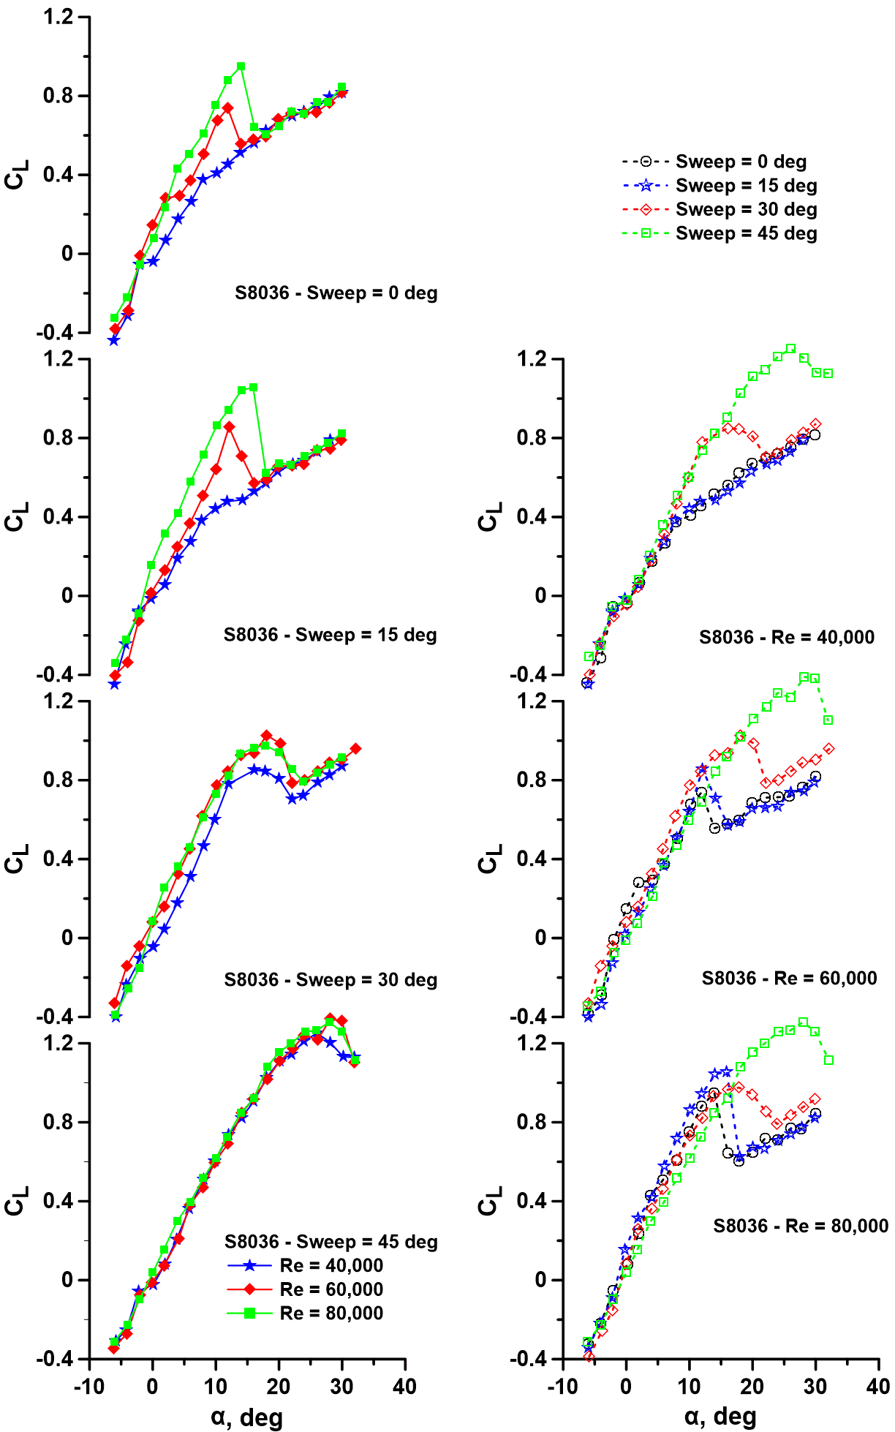
Results – C_{L} vs. AoA
Notes:
Explain what Cl is and what AOA and what the plots should look like/be showing

Slide 6
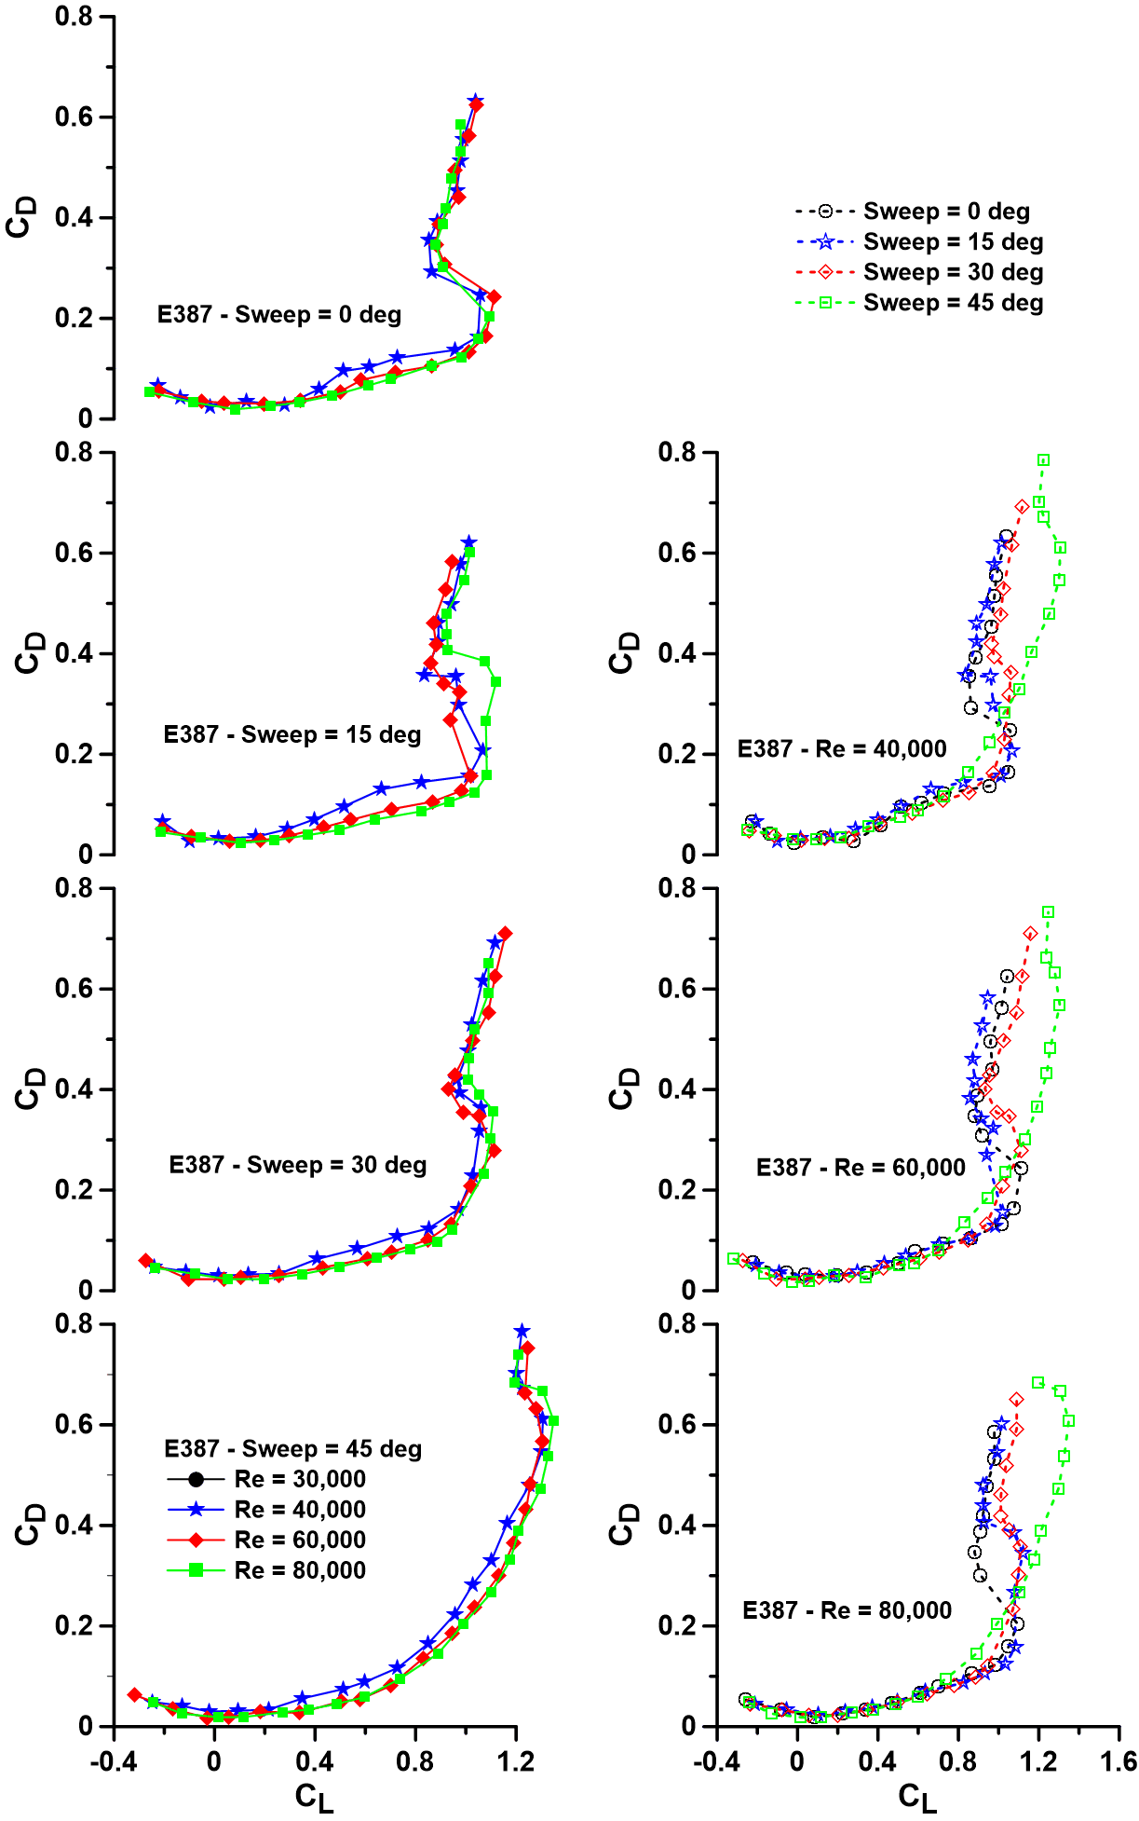
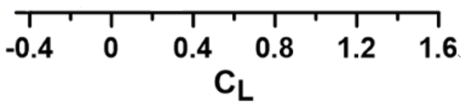
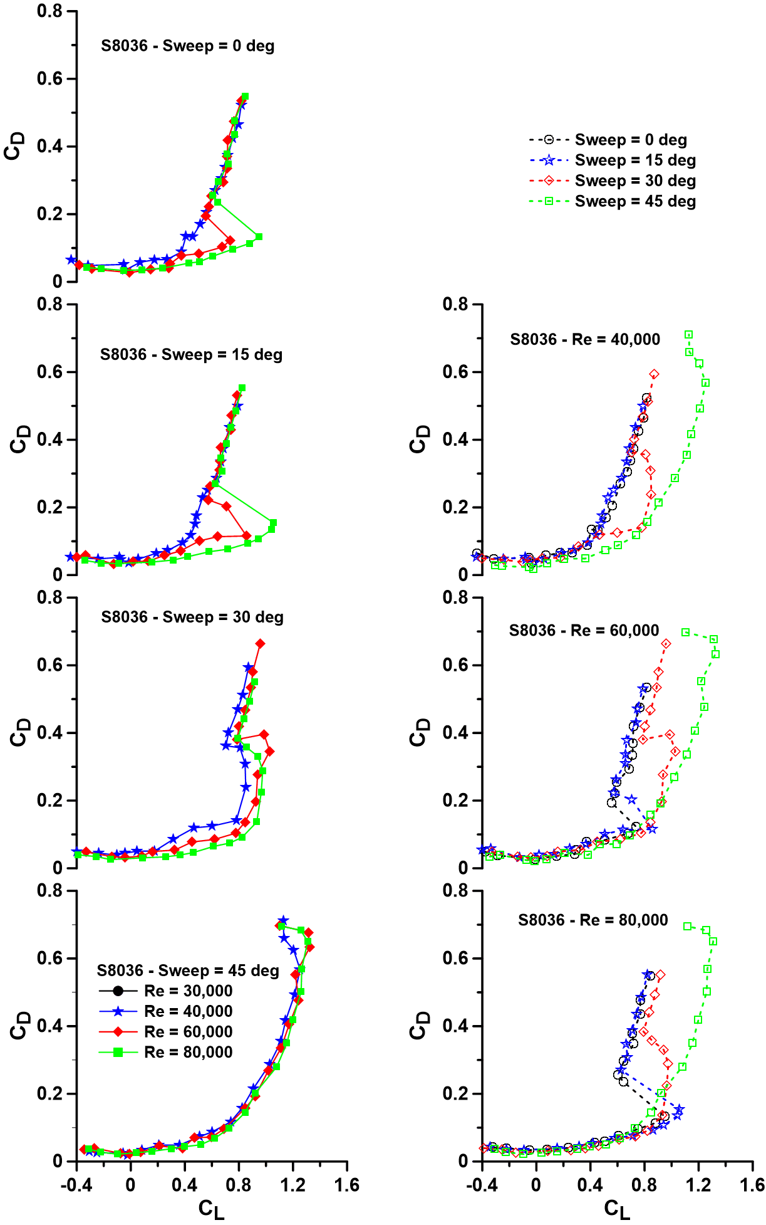
Results – C_{D} vs. C_{L}
0
0
0
0
0
0
0
Notes:
Explain what CD is and what AOA and what the plots should look like/be showing

Slide 7
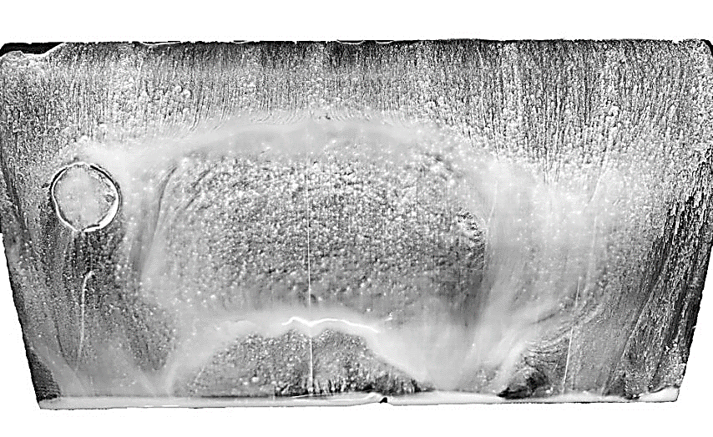
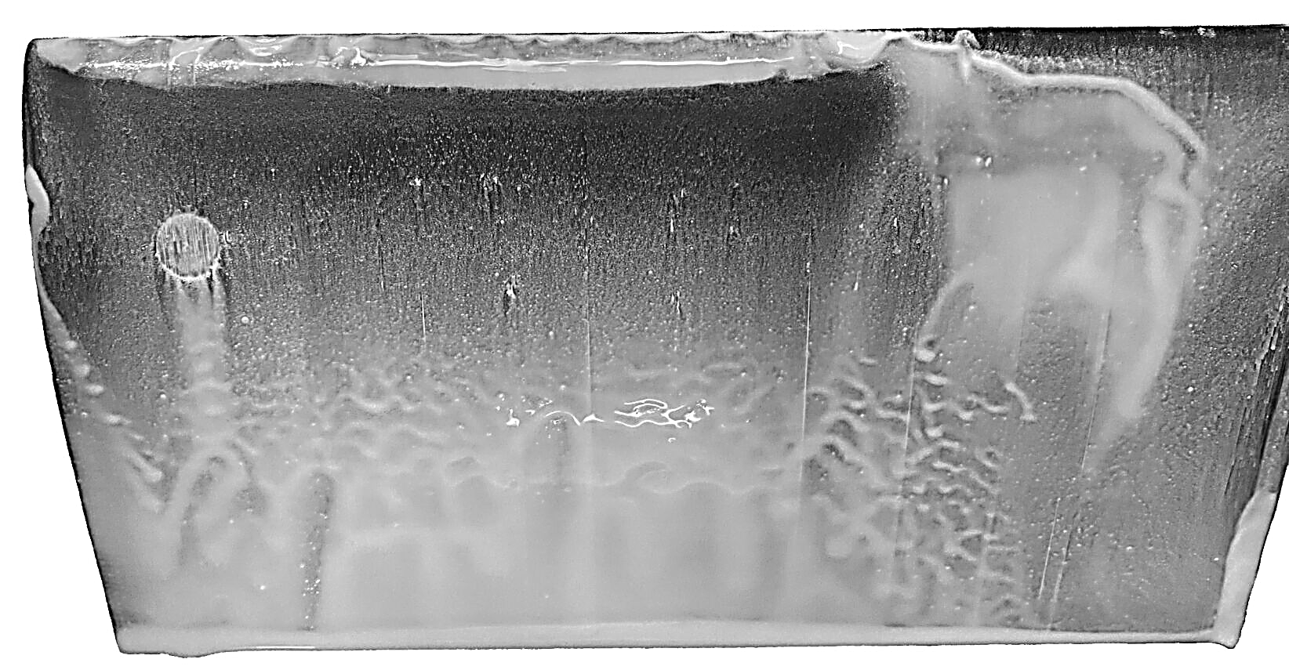
Results – Flow Visualization
Attached turbulent flow
Regions of separation
Separation cell
Region of Separation
S8036 Sweep 0° at Reynolds Number 40,000 and Angle of Attack 5°
E387 Sweep 0° at Reynolds Number 80,000 and Angle of Attack 15°
Notes:
Explain what separation is/is it good or bad? Point out what we want to be seeing

Slide 8
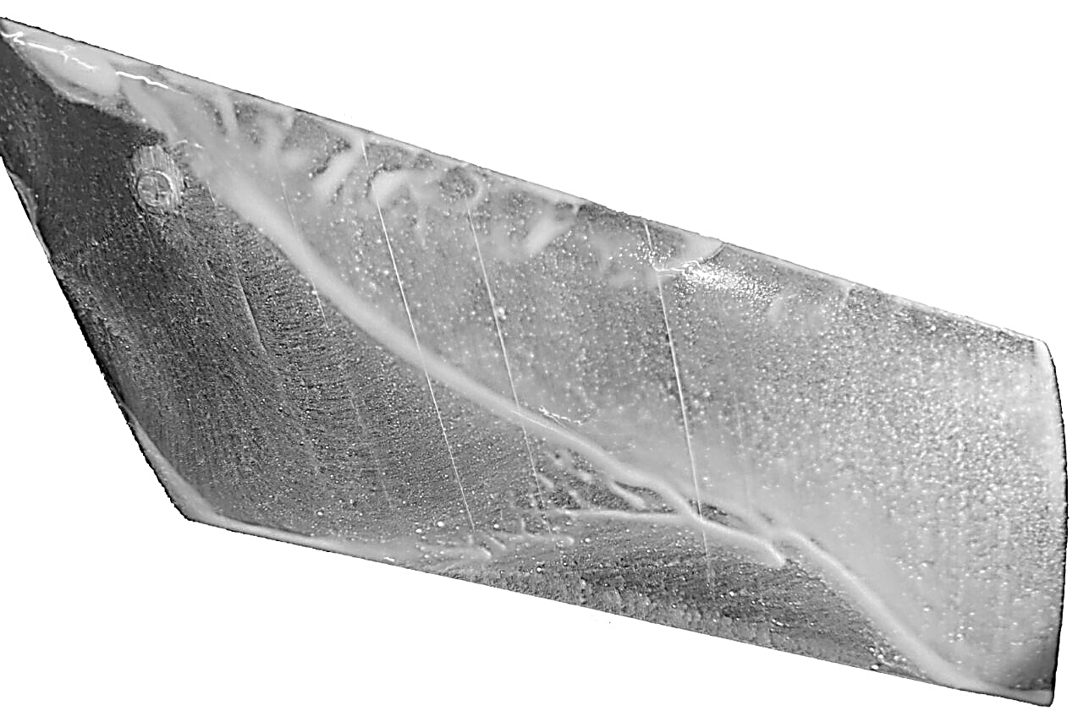
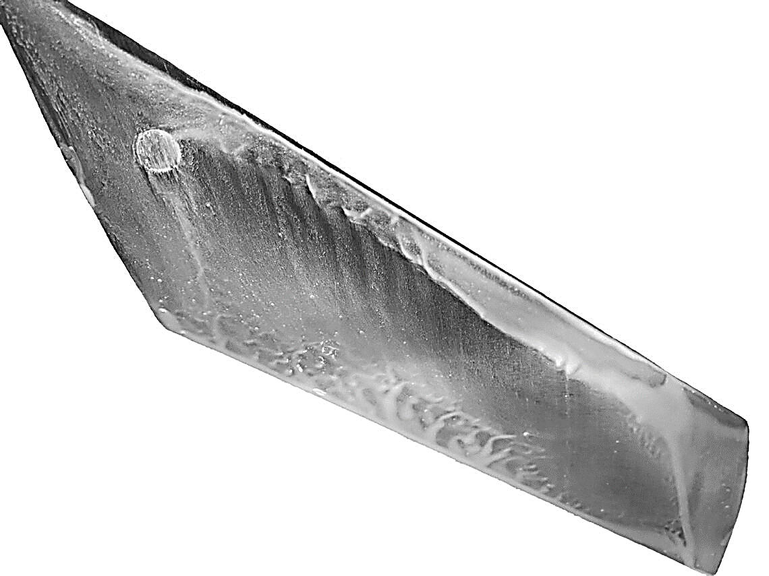
Results – Flow Visualization
Reattachment line
Leading edge separation
Separated flow
Attached spanwise flow
Attached turbulent spanwise flow
E387 Sweep 30° at Reynolds Number 80,000 and Angle of Attack 20°
S8036 Sweep 45° at Reynolds Number 80,000 and Angle of Attack 15°
Notes:
Explain what separation is/is it good or bad? Point out what we want to be seeing

Slide 9
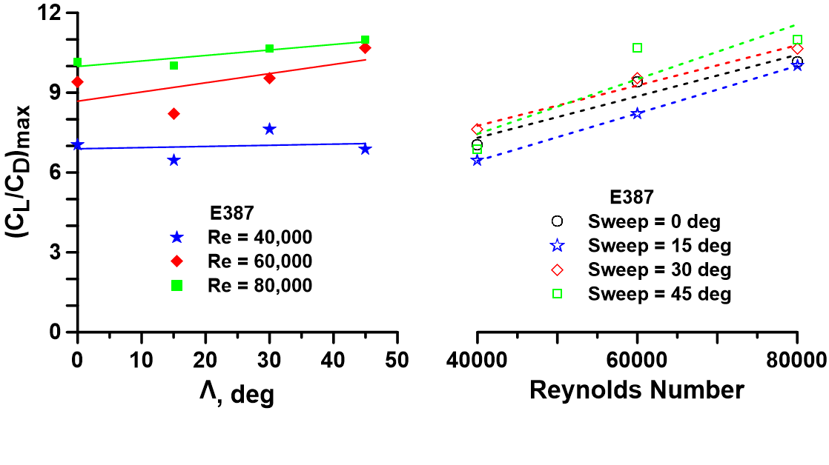
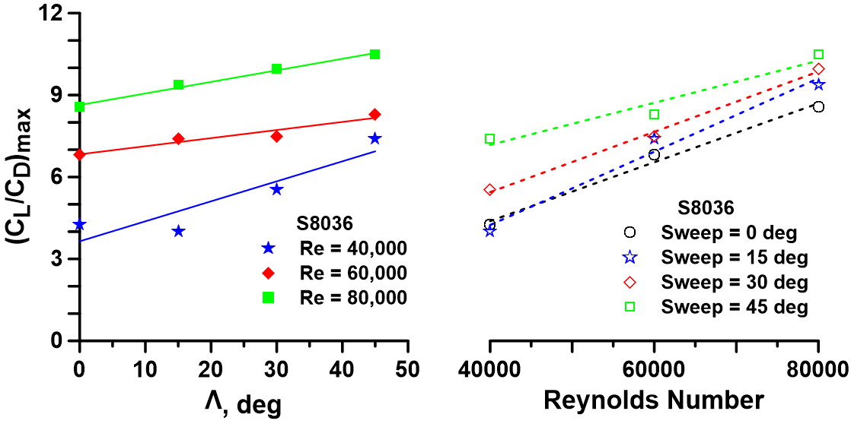
Results – Lift to Drag Ratio
Notes:
Explain what CL/CD is and what we want to be seeing

Slide 10
Conclusion
Sweep increased efficiency and performance
Maximum lift to drag ratio and maximum lift coefficient increased
Minimum drag coefficient reduced
These overall trends will help further the understanding of sweep at low Reynolds numbers and contribute to the improvement of efficient designs for UAVs and MAVs.
Notes:
Tie it back to the intro: what are sweep and Reynolds numbers/desirable outcomes/what we want to see

